Slide 1
VECHICLE TRAVELLING DATA
Retrieved from my thesis database
BY: Cecil Arthur

Slide 2
EXPLORATION OF DATA
Cleaning of data was required
Deletions of ID column
Deletion of Traffic status column
Limiting Entry data to 113
ForceAtlas2

Slide 3
Questions Formulated
Which road had the slowest traffic?
Which road did I spend the longest time? **
Figure out any interesting patterns

Slide 4
Analysis
R (local on my mac book)
Rstudio (hosted by Kpetermeni)
Gephi (stable choice)
Excel for double checking

Slide 5
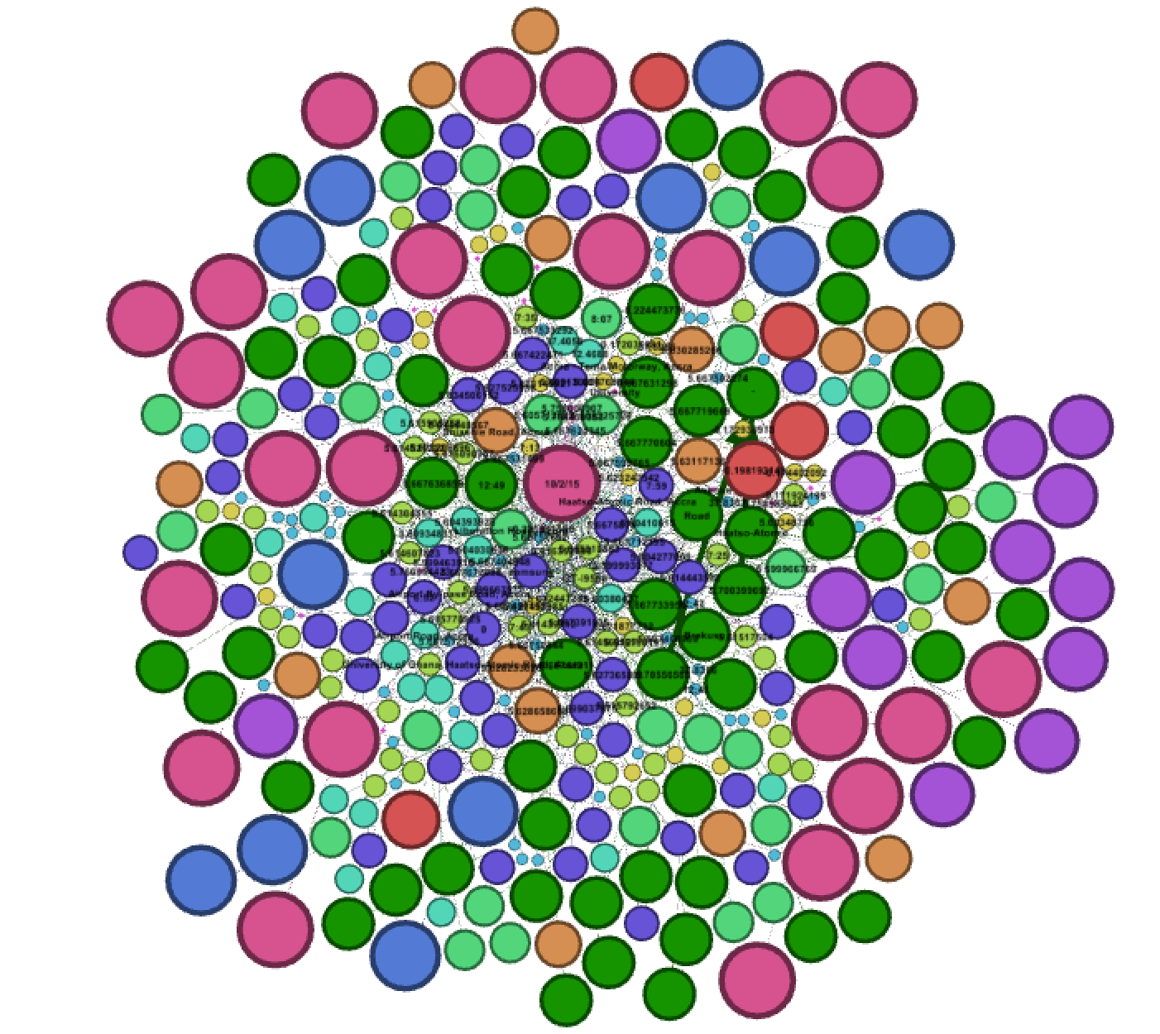
Results-clusters

Slide 6
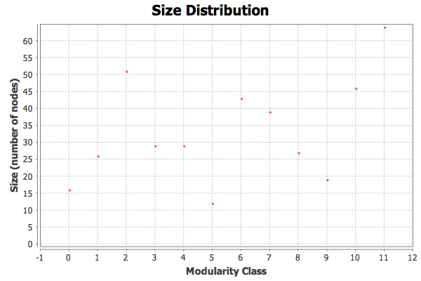
Results

Slide 7
Answers to Q’s
Which road had the slowest traffic? Airport By-pass Road, Accra
Which road did I spend the longest time? ** Airport Road

Slide 8
Observations
I expected the road with the slowest traffic to be a bigger bubble than I expected
I should have deleted the DATE Column
Interesting pattern
-Date was at the core of the beautiful chaos.
-but the Cell phone model wasn’t

Slide 9
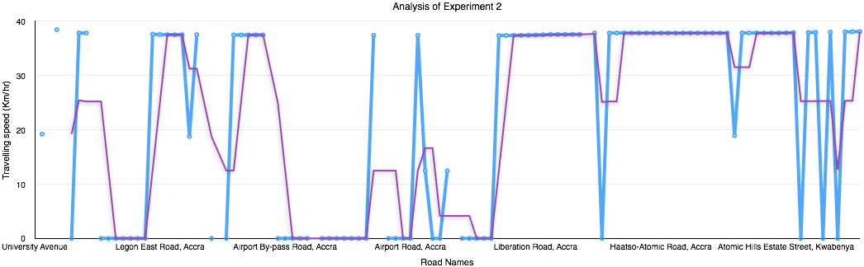
Analysis made in Excel

